Slide 1


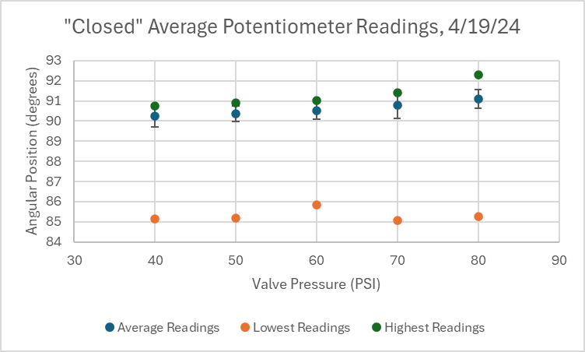
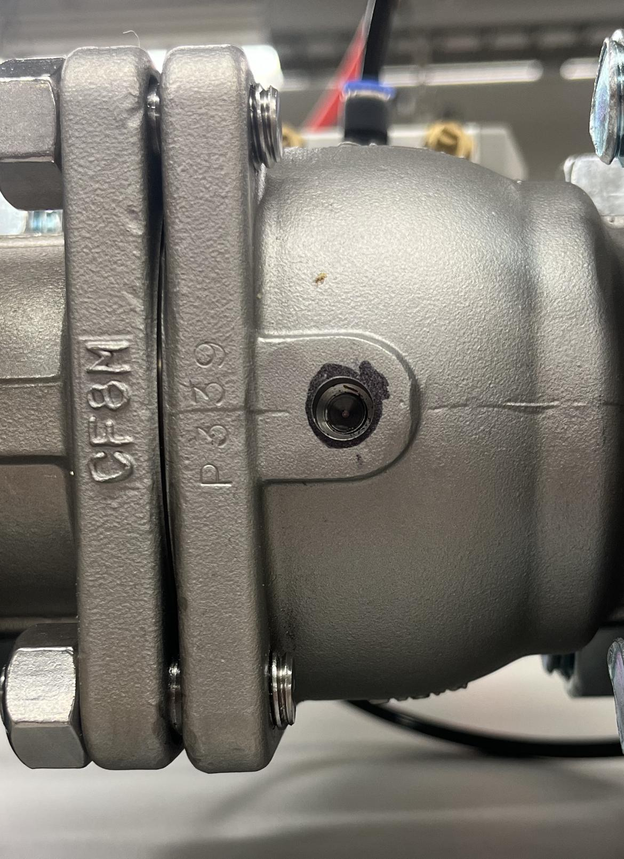
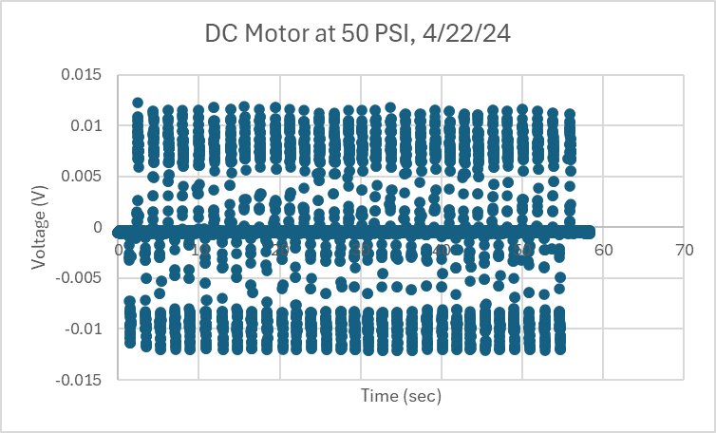
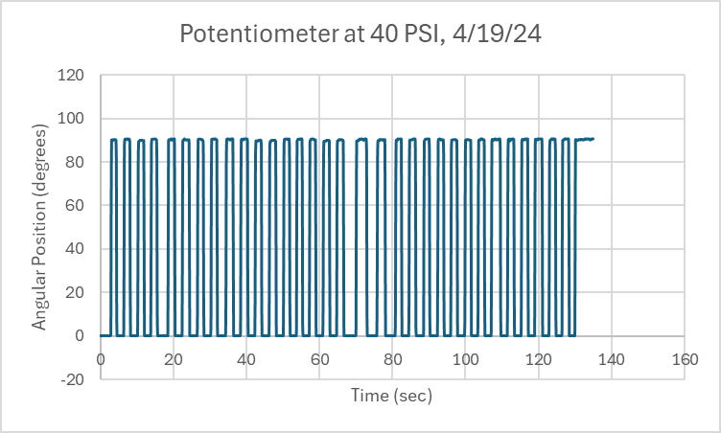
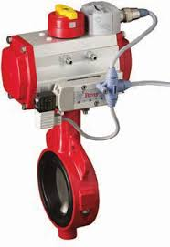
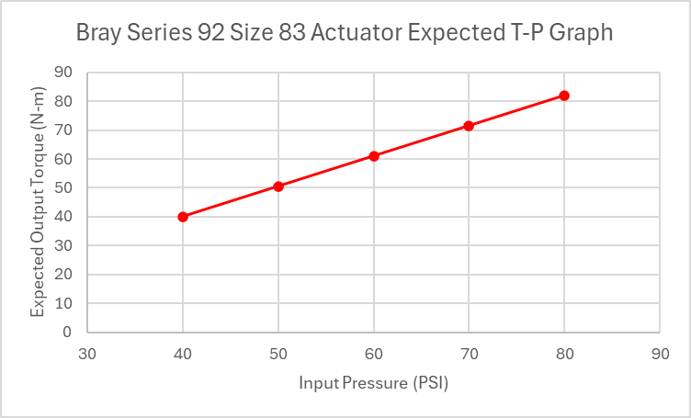
EPS Booth: 116
Embedded Valve & Actuator Sensors
Travis Carlson, Michael Hager, Avery Haynes, Locke Lehmann, Cody Sims, Zachary Walker
Dr. Steve Suh
Problem Definition
Use sensors to create a “smart” product that can accurately measure the true position of a valve and torque output of an actuator in order to track a valve-actuator system’s performance over time.
Engineering Analysis
Concepts designed to minimize sensor read error. I2C sensor protocol with a Raspberry Pi used to measure data on each sensor, compared to known values from actuator and valve documentation.
Position independent of the actuator - 2% error
Torque independent of the valve - 5% error
Position was set to 90 degrees for closed and 0 degrees for open. Then using the 2% error requirement with the 90 degree maximum it was determined that +-1.8 degrees of accuracy is required.
Expected torque was found using the technical manuals torque tables and knowing the actuator pressure input.
DC Motor measured the back emf vs time of the motor with a consistent peak voltage values. This provided a semi-linear correlation for voltage increasing with an increasing pressure input. Extrapolating these results it validates that putting a motor in line with the shaft of the actuator will yield readable results as long as the impedance of the motor is known.
Methodology
Each deliverable was broken into independent subsystems and ideas were generated to solve each problem independently. Each concept was designed and tested to then be combined into our final product.
Potentiometer to Measure Valve Position
Sensor placed inline with ball valve (bottom end) to track exact rotation during actuation
Hall Effect Sensor to Measure Valve Position
Sensor placed below the valve inline to rotation, removed 0.25 in, with a magnet attached to the rotating valve
DC Motor to Measure Actuator Torque
Sensor placed on top actuator indicator stem, the power generated during actuation measured as back EMF and used to find applied torque on valve stem.
Strain Gauges to Measure Actuator Torque
Cylindrical strain gauges inserted into actuator stop bolts, measured axial force to calculate output torque.
Figure 4. Potentiometer “closed” data readings.
Outcomes
Hall effect sensor readings were obscured behind software, but possible installation location was described.
Potentiometer measured valve position from bottom of valve rotation axis within 2% accuracy. Error sources include slight hole misalignment and epoxy imperfections.
Back EMF on DC motor was calibrated against actuator torque and was repeatable for 30 actuations with around 10% error across trials.
Strain gauges measured little to no axial force with actuator toggling - likely due to repeated installation failures. This solution was deemed too delicate for industrial field usage.
neque dignissim, and in aliquet nisl et umis.
Figure 6. Ideal location for position measurements
Impact
Findings have implications on methodologies that can be used to embed smart sensors into valve & actuator systems to track performance. Future work could include:
Sensor Selection: Sourcing higher-quality sensors capable of matching Bray system service life
Sensor Calibration: Develop methodologies for correlating back-emf voltage data to actuator torque.
DFMX Analysis: Optimize machining techniques used to install sensors for manufacturing & assembly whilst meeting ASME & ISO standards.
Figure 2. Sample DC motor data during actuations.
Figure 3. Potentiometer readings during repeated actuations.
Figure 5. Example butterfly valve with actuator attached.
Table 1. Potentiometer “closed” data readings.
METHODOLOGY VALIDATION Potentiometer measured the full 90 degrees of rotation within 2% error, proving that attaching the stem of the potentiometer to the floating ball valve can yield accurate position results. It also verified that the potentiometer system does not fracture from the floating ball valves movement.
References
“Piping Codes and Valve Standards”. Valve Magazine, 09/29/2015,
“Pneumatic Actuator: Series 92/93 Rack & Pinion Pneumatic”. Bray International, Inc, n.d.,
“Rotary Potentiometer - 10k Ohm, Linear”. Osoyoo, May 7, 2015,
“A Comprehensive Guide on Butterfly Valve Vs Ball Valve”. Dombor Valve, 2021
“Fluid Power Actuators Explained”. Rotork Fluid Systems, May 2016,
PSI | 40 | 50 | 60 | 70 | 80
Average | 90.25934 | 90.3712 | 90.52066 | 90.78631 | 91.1062
St.Dev. | 0.553806 | 0.378825 | 0.439164 | 0.63549 | 0.46071
High | 90.74432 | 90.89264 | 91.01624 | 91.41174 | 92.30988
Low | 85.1413 | 85.1825 | 85.84991 | 85.0589 | 85.26489
% error | 1.227145 | 0.838375 | 0.970307 | 1.399968 | 1.01137
Figure 1. Expected linear actuator torque curve.
Acknowledgements
Bray International, FEDC, Dr. Steve Suh, Dr. Wei Chen

